Slide 1
Airline Tweets Sentiment Analysis
Adam DeJans
CSI 5810

Slide 2
Goal
Use sentiment analysis on airline tweets to discover a ranking or approvals and comparison of four major US airlines:
@americanair
AA
#americanairlines
#americanair
@delta
DELTA
#deltaairlines
#deltaair
@southwest
SOUTHWEST
#southwestairlines
#southwestair
@united
UNITED
#unitedairlines
#unitedair
Additional goal: Discover the reasons for negative tweets and areas of improvement for airliners from a business analyst perspective

Slide 3
Collecting Tweets
Tweepy is open-sourced and enables Python to communicate with Twitter platform and use its API
Data was collected by querying the associated hashtags with each airline within the specified date of one week
One week of data corresponded to 1584 + 178 + 375 + 440 = 2577 tweets
Using tweepy API

Slide 4
Preprocessing
Tokenization
Given a character sequence and a defined document unit, tokenization is the task of chopping it up into pieces, called tokens, perhaps at the same time throwing away certain characters, such as punctuation.
Regular Expressions
Lower Cases, Eliminate URL’s, Replace #hashtags, Remove Additional Spaces
Stop Words
E.g., “the”, “is”, “are”

Slide 5
Classifying Tweets
Importing the “TextBlob” package we’re able to determine the polarity of each tweet with the call analysis.sentiment.polarity
Polarity is a score of the tweet in the range [-1.0, 1.0] , which measures whether the tweet is positive, neutral, or negative.
I’ve defined the following classes:
Negative
Neutral
Positive
-1.0
-0.10
0.10
1.0

Slide 6
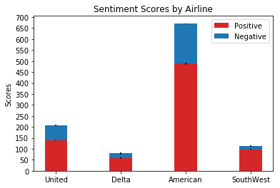
Positive and Negative Sentiment Distribution per Airline
Here we see that the general consensus across all airlines is that there is a larger portion of positive tweets to each airline as opposed to negative

Slide 7
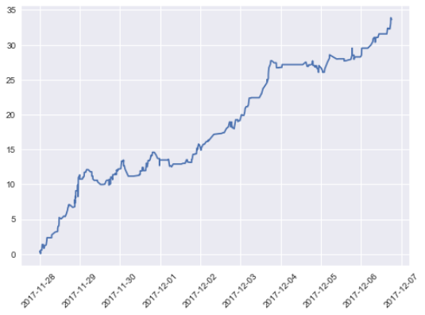
Cumulative Sum of Polarity Scores over Time
All four airlines gave a similar display to that of United AIrlines (pictured)

Slide 8
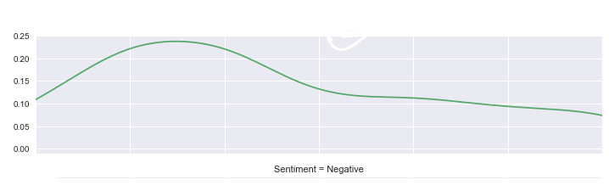
When are Customers most frustrated?
We see that negative tweets occur most frequently during the beginning of the work week. This could be explained by disgruntled employees that travel for work?
M
T
W
F
Sa
Su

Slide 9
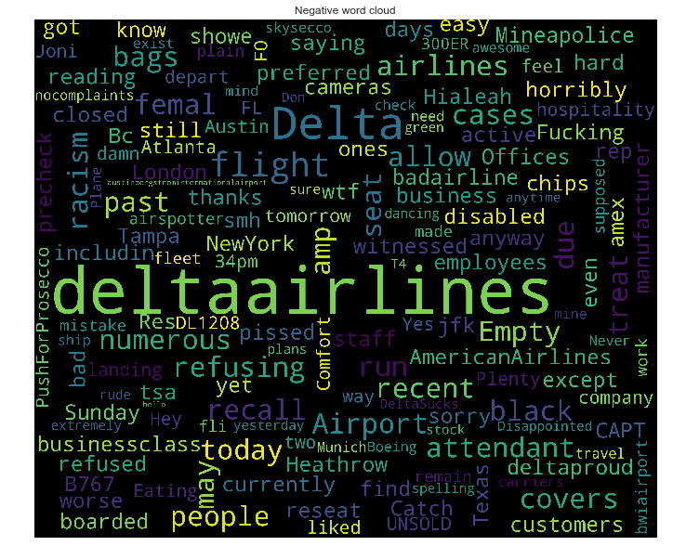
Reasons for frustrations
We see keywords such as:
Racism
Mistake
Precheck
Reseat
Refusing/Refused
Bags
Sorry
Staff
Rude
These keywords could be used as indicators to the company as areas to work on to boost public relations

Slide 10
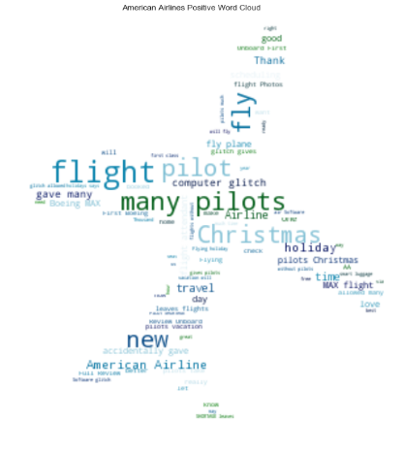
Keeping & Gaining Customers
Looking at the positive tweets we can see what customers want from airliners
Some top words:
Free
New
Many
Pilot(s)
Customer
Service

Slide 11
Lesson Learned
“My favorite airline of all time...#SouthwestAirlines”
Polarity = 0.5 (rather high)
Machines are not good at sensing sarcasm

Slide 12
Results
There’s no clear distinction on the top reasons why airlines receive negative feelings
Almost all airlines suffered from the same top negative words
Twitter may not be a sufficient way to rank airlines due to the relatively small number of tweets (and bias)
Overall Delta and Southwest have the best ratio of positive to negative tweets, followed by United and then American
Interestingly this ordering follows precisely the ranking of these four airlines that is given on cbsnews https://www.cbsnews.com/media/these-are-the-best-and-worst-u-s-airlines/14/

Slide 13
